Slide 1
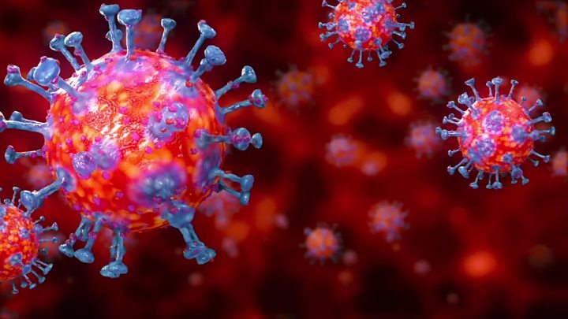

EDA on COVID-19 Impact in India
Jyoti Sankar Sahoo
Jan 2020 Batch

Slide 2
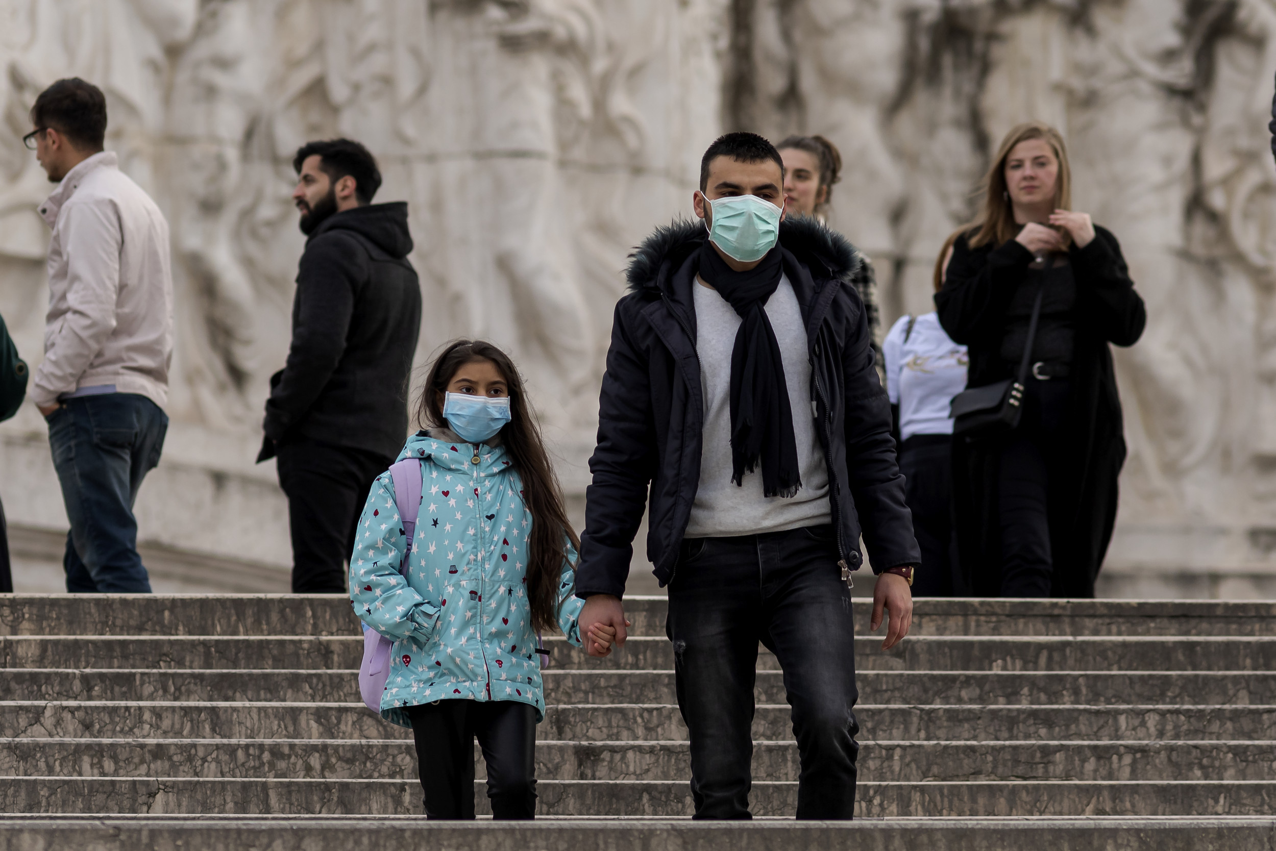

Total Cases in India
27891
Total Number of Patient Recovered
6638
Total Number of Patient Deceased
844
Active Cases in India
20409*
* The Data is till 28th Apr 2020

Slide 3


COVID-19 Case Study
Background Analysis:
Coronavirus disease 2019 (COVID-19) is an infectious disease caused by severe acute respiratory syndrome coronavirus 2 (SARS-CoV-2).
The first case was reported in Wuhan City of China and after that the whole world is now affected with this deadly disease.
The Dataset Info:
The data set contains the raw data based on COVID-19 patients in India. The information like Detected State, City, Patient Age, Travel History etc. are providing insightful analysis of the data.
The dataset contains the data till 28th Apr 2020 for India.
There are 27891 entries with 20 columns.
The Following Information are NOT Available:
Name of the Patients.
Longitude and Latitude data for exact location.
Admitted Hospital information.
Notes:
I have collected this dataset from online portal for COVID 19 and the raw data contains information of patients who are identified as affected.

Slide 4

Objective of EDA
EDA Objectives:
This Exploratory Data Analysis is to showcase the Python skill learnt till now and application of those.
The EDA involves key actions such as Data Loading, Inspecting, Profiling, Pre-processing, draw Insights in terms of visuals and Conclusion generation.
The Key Outcomes of EDA:
Total number of cases in India.
Active COVID-19 cases.
Recovered COVID-19 Cases.
Deceased Numbers in India.
Most Affected State and City.
COVID-19 Impact on Age Group and Gender.
Current Status Distribution
Notes:
The main objective of this EDA is to apply my acquired knowledge to analyze a dataset and to draw meaningful insights.

Slide 5

Dataset Observations
Dataset Observations:
27891 Entries and 20 columns.
Key columns are Detected State, Detected City, Age Bracket, Gender, Date Announced, Current Status, Backup Notes etc.
Age Bracket column contains missing values which are adjusted with mean value.
The data set contains data till 28th Apr 2019 and for India Country only.
Other unused columns which are not necessary for our observation were deleted during data pre-processing stage.
The Gender column which is one of the important column for drawing insights, contains missing values but we can’t pass any random values.
The Current Status column contains detail information of patient current health and this is the most important column for the analysis.
Notes:
27891 cases are identified as positive in India till 28th Apr. Contains information like Detected State, Age, Gender current status which are important factors to be consider while drawing insights.

Slide 6
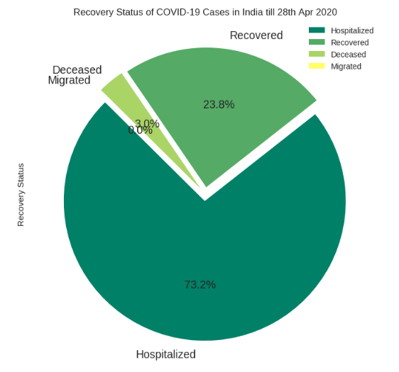
Insights from Data
Recovery Status of COVID-19 Cases in India:
As per the Pie Chart the majority of cases are still active. More than 73% of the cases are still Hospitalized.
The recovery is progressing in a good note and this only can possible because of our Doctors and Health workers. The current recovery rate is approximately 24% and the number will definitely increase in coming weeks.
The Deceased rate is quite low which is again because of proper treatment by the Doctors and Health Workers. So Kudos to them.

Slide 7
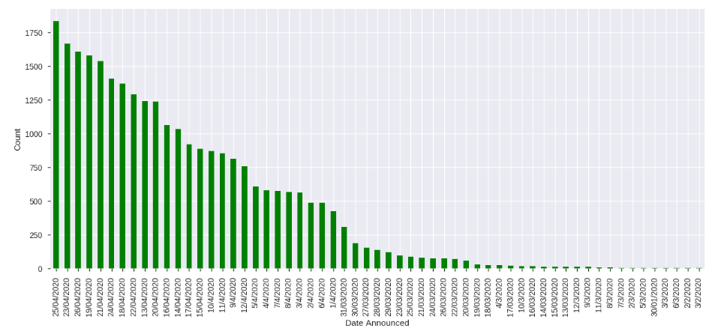
Insights from Data
Total COVID-19 Cases Trend by Announced Date:
The trend shows the total cases are increasing rapidly day by day in India.
The last recorded case count for 28th Oct 2020 was 1878 and comparing to the cases in last month it is a far big number.

Slide 8
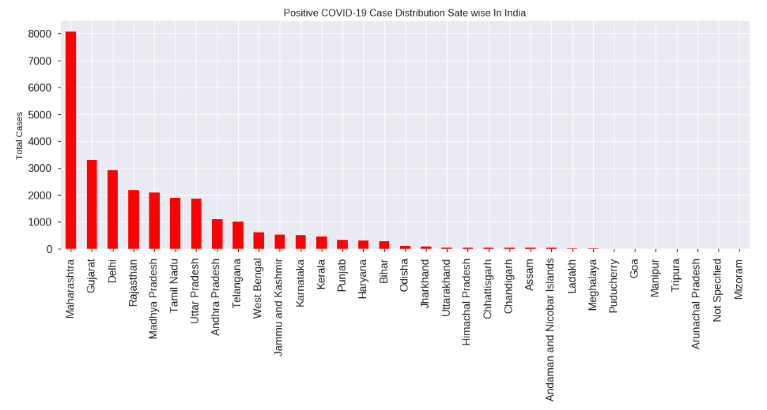
Insights from Data
Positive COVID-19 Case Distribution by States of India:
From the Bar chart it is clear that Maharashtra state recorded the highest positive cases while Mizoram recorded the lowest positive cases.

Slide 9
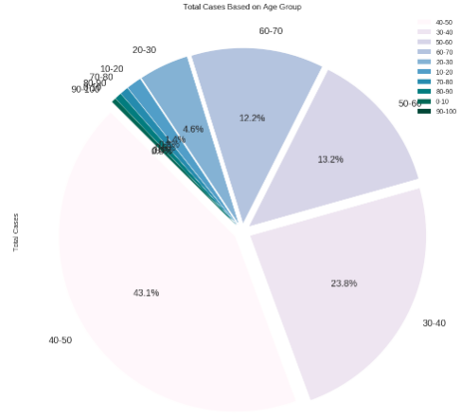
Insights from Data
Total Cases Based on Age Group:
40-50 Age Group highly affected followed by 30-40 and 50-60 Age Group may be because these age group people are mostly working and everyday commutation and interaction with other people increases these numbers.
0-10 age group and 90-100 age group are least affected may be due to extra care and precautions or due to less number of people available (specially for 90-100 age group).

Slide 10
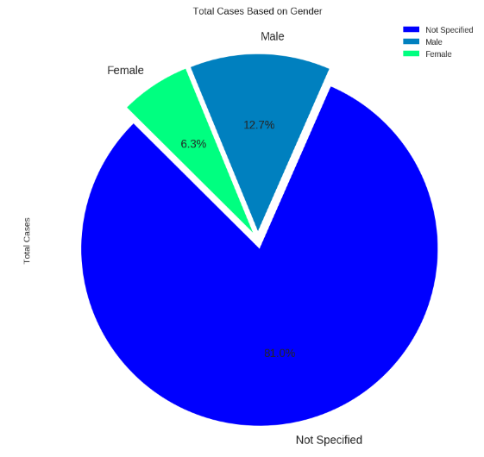
Insights from Data
Total Cases Based on Gender:
In this data more than 80% gender information are not specified. But ignoring that it is clearly visible that the affected Male ratio is almost double than Female which may be vary based on the Not Specified data.

Slide 11
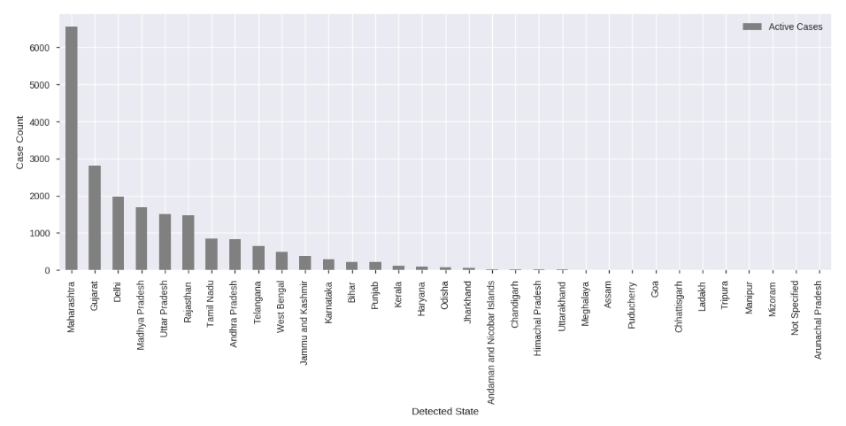
Insights from Data
Active Cases Distribution by States:
Maharashtra has highest number of Active cases and Arunachal Pradesh having least number of active cases.

Slide 12
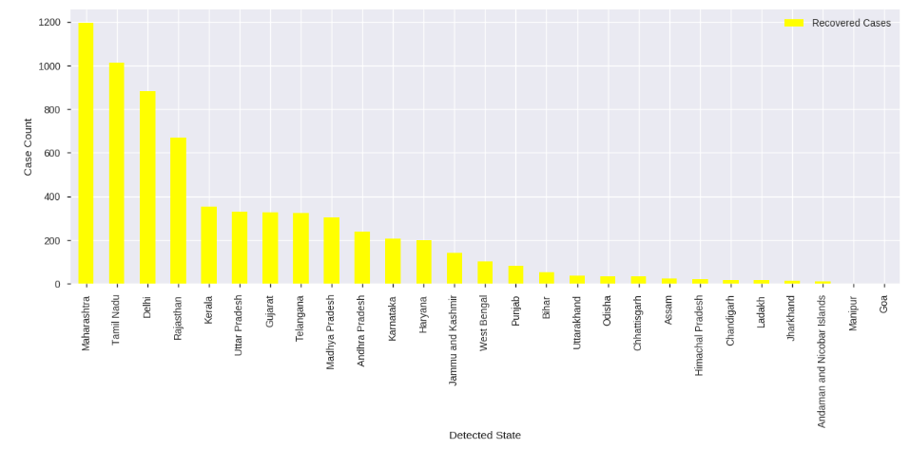
Insights from Data
Recovered Cases Distribution by States:
Maharashtra State is having the highest number of Recovered Cases and this is quite obvious as the total number of cases are also highest in the State.
Here we can notice that States like Tamilnadu and Kerala who stood at 6th and 13th rank respectively for Total Positive Cases Detected is now occupied the 2nd and 5th rank respectively for Total Patients Recovered which is a great achievement. And this gives us the information about how the health care system are doing in each State so that the Government can take necessary steps to improve the same by spreading awareness among people and providing necessary equipment to Hospitals to improve the recovery rate.

Slide 13
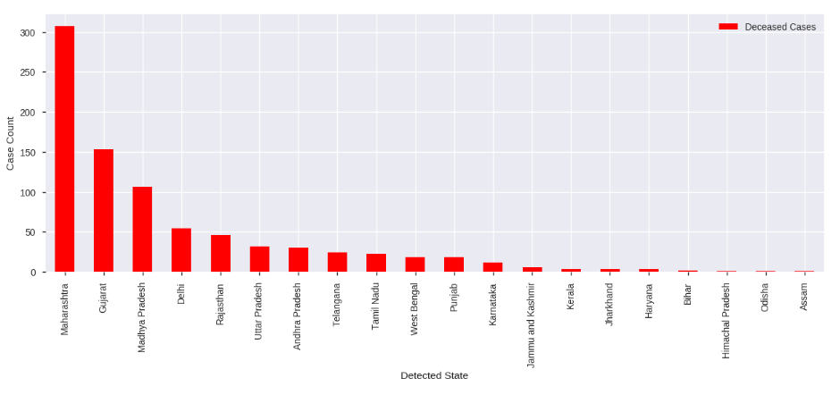
Insights from Data
Active Cases Distribution by States:
Again as 3% of the total patients are died so here we are showing the State wise death rate due to COVID-19.
Maharashtra tops the list followed by Gujarat and MP.
Himachal Pradesh, Odisha and Assam States are having lowest death rate.

Slide 14


Conclusion
It is analyzed that COVID-19 cases are increasing very rapidly in India.
The recovery is also in good progress. How ever the Percentage of Recovery will only improve when the Number of Positive Cases will decrease and to do the same everyone should understand the effect of this deadly COVID-19 virus and take necessary precautions.
The Health care team are doing a fabulous job and also the best decision Lock Down by the Indian Government has really helping to Stop the Spread.
All the Hospital Staffs who are helping the patients to recover must be supplied with necessary equipment. Government should take necessary steps to arrange those.
Strict Police action should be taken against the people who are violating the lockdown rules.
Child and elderly people should be taken care properly to boost their immunity.

Slide 15
Thank You!!
#StayHomeStaySafe
#StopTheSpread

